Slide 2
Azure Overview

Slide 3

Azure Overview
Azure Web Apps
Azure Storage + Cognitive Services
Azure Machine Learning
Azure Stream Analytics
Azure High-Performance Computing
KEEP
CALM
HERE'S THE
AGENDA

Slide 4

What is the Cloud?
Notes:
In the early days, the "cloud" was primarily a place to host VMs and park data. Today, it is so much more. Azure offers more than 100 different services enabling you to do anything from storing data in blobs to building rich and sophisticated machine-learning models. The REAL story about what's happening in the cloud these days is Software as a Service (SaaS), in which higher and higher level services are being made available with a few button clicks. Just one example: researchers who use Apache Spark are probably well aware of the time, expense, and aggravation involved in setting up and maintain a single Spark server, much less a cluster of Spark servers. With Azure HDInsight, you can spin up a Spark cluster in minutes with all the relevant software preinstalled and ready to go to work. Or how about the recently announced Linux Data Science Virtual Machine (https://azure.microsoft.com/en-us/marketplace/partners/microsoft-ads/linux-data-science-vm/)? From the documentation:
This Linux based virtual machine contains popular tools for data science modeling and development activities. The main tools include Microsoft R Open, Anaconda Python distribution, Jupyter notebooks for Python and R, Postgres database, Azure command line tools, libraries to access various Azure services like AzureML, databases, Azure storage and big data services. It also has machine learning tools and algorithms like CNTK (a deep learning toolkit from Microsoft Research), Vowpal Wabbit and xgboost.
THIS IS THE FUTURE…one in which the cloud provides for you, with low cost, high reliability and availability, and no hassle, the tools you need to do your job, whether you're a genomics researcher needing tools and CPU power to analyze massive amounts of data, or a developer looking to build apps that scale to meet demand and utilize rich APIs (such as the Microsoft Cognitive Services APIs) that are only available in the cloud.

Slide 5
>250k
Greater than
1,500,000
>500m
Azure Active Directory Users
Active websites
SQL Databases in Azure
>1
>777
TRILLION storage
transactions per day
>80%
Fortune 500
Use Azure
MILLION
Developers registered with Visual Studio Online
>1.5
TRILLION messages/mo processed by
Azure IoT
>13
BILLION
authentications/wk
Notes:
These are just a few statistics denoting the massive scale of Azure. Such scale is possible because Microsoft has invested billions of dollars building data centers around the world. The point isn't to brag; it's to demonstrate that someone else (Microsoft) has invested the billions needed to make this happen, and YOU are the beneficiary of the resulting massive economy of scale.

Slide 6



Azure Data Centers
North America
Europe
Asia Pacific
Central Canada
N. Europe
N. Central US
East Canada
Central US
W. Europe
Japan West
West US
East US
China North
Japan East
East US 2
Central India
China South
S Central US
E. Asia
S.E. Asia
West India
Brazil South
South India
Australia East
Australia Southeast
Notes:
Azure is generally available in 24 regions around the world, and has announced plans for 8 additional regions. Geographic expansion is a priority for Azure because it enables customers to achieve higher performance and it supports their requirements and preferences regarding data location. Newly announced regions include US DoD East, US DoD West, Germany Central, Germany Northeast, UK South, UK West, Korea Central, and Korea South. Not shown on this map are US Gov Iowa and US Gov Virginia. The Chinese and (soon) German data centers are available only in those countries due to laws regarding the storage of data in those locations. In Germany, for example, the law forbids German companies from storing data in the cloud outside Germany.

Slide 7
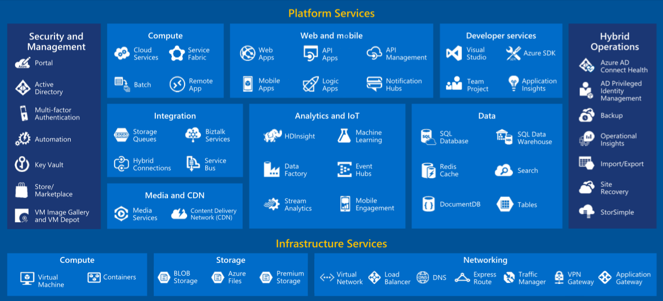
Azure Services
Notes:
Azure is a wide-ranging and comprehensive cloud-computing platform that is evolving every day with new features and services. Currently, Azure includes more than 100 different services, ranging from IaaS services such as VMs to rich SaaS services such as Azure Machine Learning, Azure Stream Analytics, and Azure HDInsight.

Slide 8
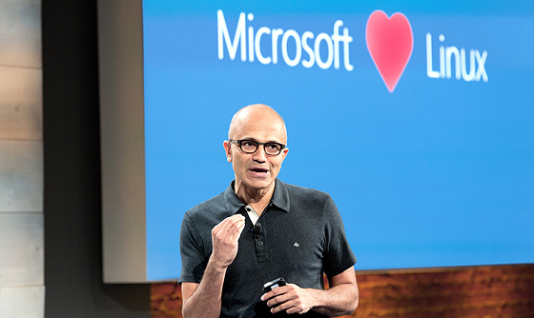
Notes:
Just because Azure comes from Microsoft doesn't mean it's Windows-centric. Azure loves Linux, and much of the ongoing development taking place in Azure today is designed to make it the best cloud platform in the world for hosting Linux and popular open-source tools that run on it.

Slide 9
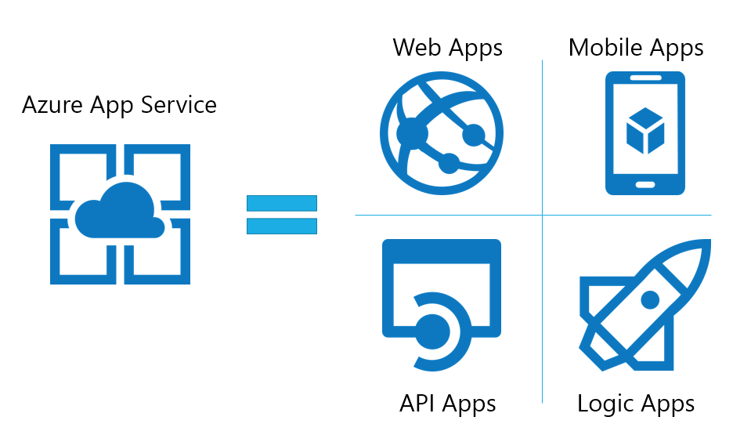





Publish a Web Site
Use prebuilt templates to build a personal Web site with technologies you know, or create a commercial Web site that scales to serve millions of customers
Notes:
Azure Web Apps, which are part of the Azure App Service family, allow you to publish Web sites/apps using a variety of popular technology stacks. To help, the Microsoft Azure Marketplace contains thousands of free templates for deploying apps, services, virtual machines, and more, preconfigured for Azure and provisioned with popular tools such as WordPress, CakePHP, Joomla, and Django.

Slide 10
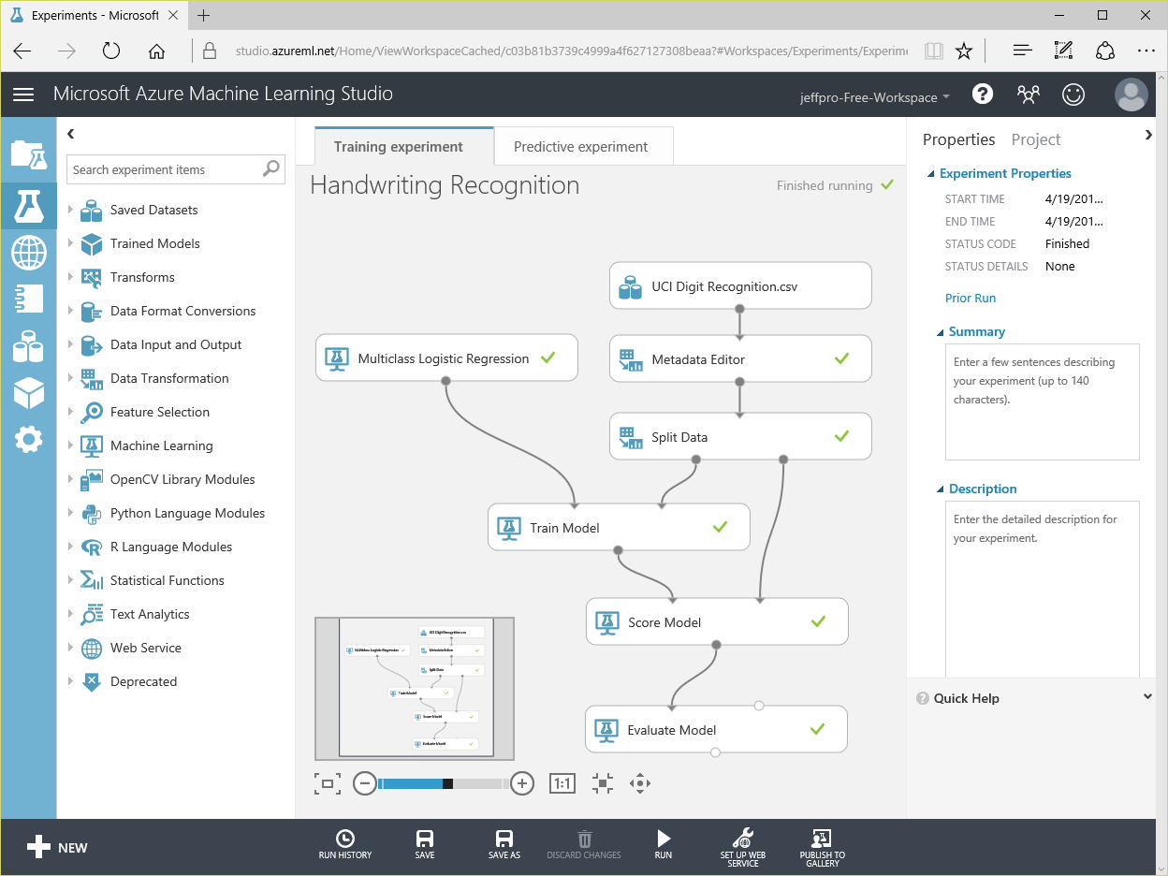


Perform Real-Time Fraud Detection
Train a model with Azure Machine Learning and use that model to classify credit-card transactions as fraudulent or not fraudulent
Feature | Value
Name | Bill Gates
Age | 60
Gender | Male
Amount | $352.00
Purchased | Software
Location | Redmond, WA
Time | 3:15 p.m.
… | …
Notes:
Machine learning is an offshoot of AI that finds patterns in large volumes of data and uses those patterns to perform predictive analytics. A classic example of ML at work is how credit-card companies detect fraudulent transactions in real time (or near real time). They train a model with millions of transactions, each classified as "fraudulent" or "not fraudulent." Features of the model include data such as the identity of the card holder, the time and place of the transaction, the type of goods or services purchased, location of purchase, and amount of purchase. Then each time a new transaction occurs, they feed that into the model and are told whether the transaction should be flagged as fraudulent -- with an astonishing degree of accuracy. Azure Machine Learning is an SaaS offering that combines rich analytical capabilities with a drag-and-drop user interface that makes building sophisticated ML models extraordinarily easy.
Another example of how ML touches us every day is spam detection. Train a model with millions of e-mail messages, each classified as spam or not spam, and then use that model to determine whether the next message arriving in your inbox should be moved to the junk folder.

Slide 11
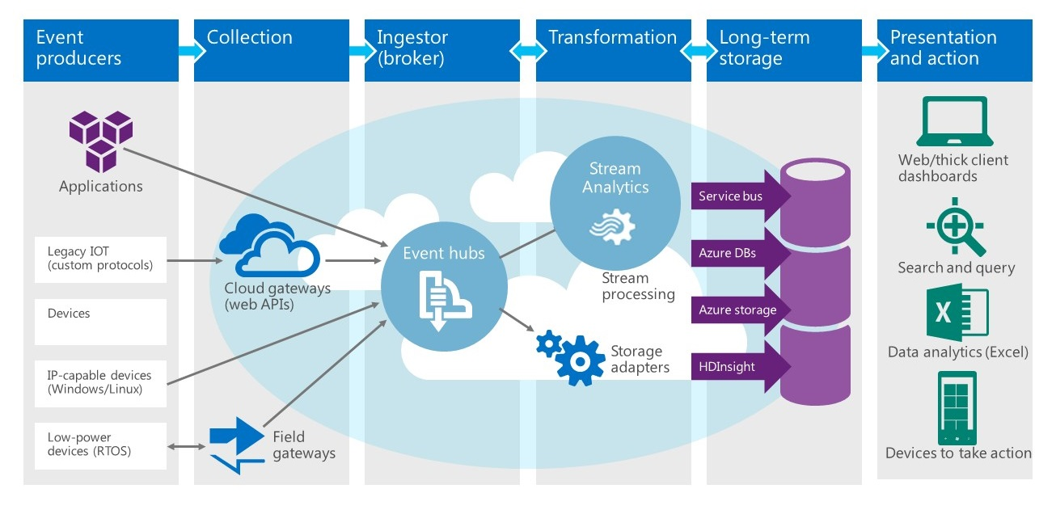
Process Data from IoT Devices
Combine Azure Event/IoT Hubs, Azure Stream Analytics,
and Azure Storage to analyze IoT data streams in real time
Notes:
Querying static data sources such as databases is an established and well-understood science. Extracting information from fast-moving data streams, such as those emanating from millions of IoT devices, is much more challenging. Azure Stream Analytics provides a solution by layering an enhanced version of the SQL query language over dynamic data streams. Combined with other Azure features such as event hubs and Power BI, it can be used to build real-time systems that analyze -- and allow you to respond to -- events as they happen.

Slide 12
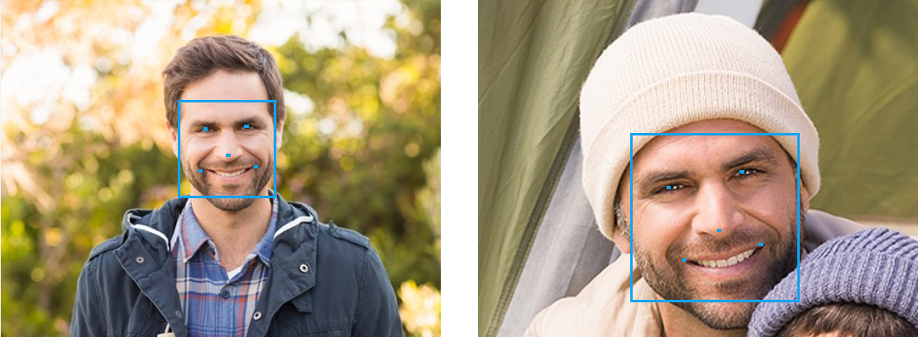
Identify Faces
Use the Cognitive Services Face API to compare
faces, identify faces, search for similar faces, and more
Notes:
The Microsoft Cognitive Services Face API (https://www.microsoft.com/cognitive-services/en-us/face-api) includes methods for detecting human faces, comparing faces for similarity, organizing people into groups according to visual similarity, identifying people previously tagged people in images, and more. It is one of more than 20 APIs in the Cognitive Services family that enable developers to build intelligent apps by embedding functionality that is the product of years of research.

Slide 13
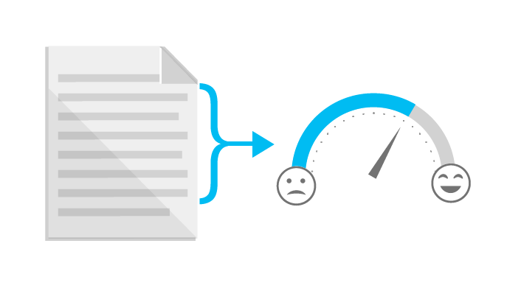
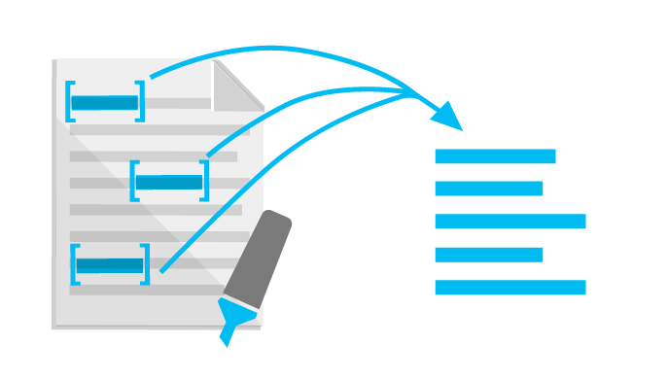
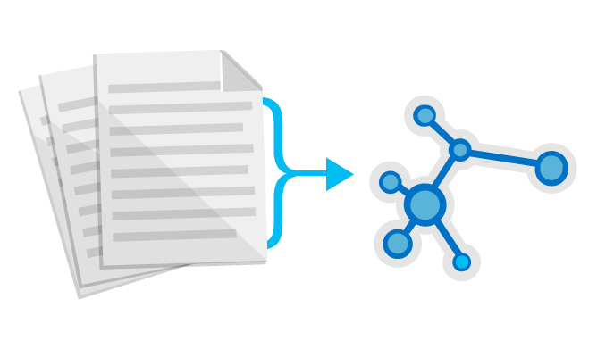

Perform Sentiment Analysis
Use the Cognitive Services Text Analytics API
to analyze sentiment in text files, Twitter feeds, and other sources
Sentiment Analysis
Key Phrase Extraction
Topic Detection
Language Detection
“Thanks to Text Analytics…we are able to incorporate guest sentiment into our actionable guest feedback platform that delivers a comprehensive view of guest satisfaction and server performance.”
— Al Pappa, Head of Business Intelligence, Ziosk
Notes:
The Microsoft Cognitive Services Text Analytics API (https://www.microsoft.com/cognitive-services/en-us/text-analytics-api) includes methods for sentiment analysis, key-phrase extraction, topic detection, and language detection. The sentiment-analysis API accepts text as input and returns a numeric score between 0 and 1. Scores close to 1 indicate positive sentiment and scores close to 0 indicate negative sentiment. Sentiment score is generated using classification techniques. The input features of the classifier include n-grams, features generated from part-of-speech tags, and word embeddings. Currently, English, French, Spanish, and Portuguese text are supported.

Slide 14
Many Languages, Many SDKs
Write code in any language and for any platform
Azure SDKs available for a variety of languages and platforms (free)
Also available in package form from NuGet and NPM
Ramp up quickly by using what you already know
.NET
Node.js
Java
Python
Ruby
PHP
C++
iOS
Android
Notes:
You don't have to learn C# to build apps that utilize Azure. SDKs are freely available for a variety of popular languages and platforms. You can get started quickly by using what you already know.

Slide 15
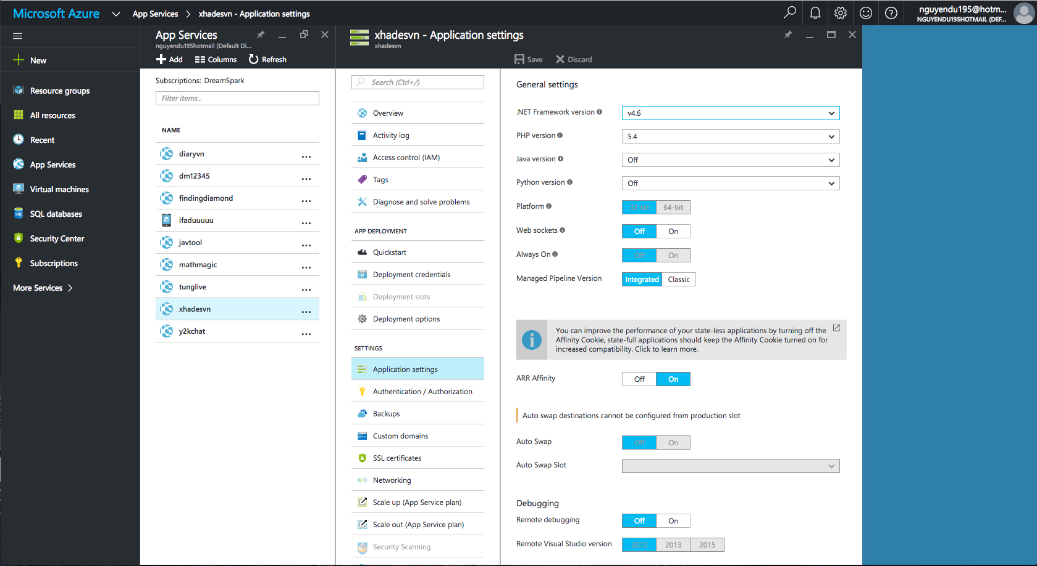
Azure Portal
https://portal.azure.com
Notes:
The Azure Portal is your gateway to all things Azure. This is where you create Azure resources and connect them together to form comprehensive solutions, manage those resources, and monitor billing.

Slide 16
Azure Web Apps

Slide 17





Azure App Service Family
Web Apps
Web apps that scale with your business
Mobile Apps
Build mobile apps for any device
Logic Apps
Automate business processes across SaaS and on-premises
API Apps
Build and consume APIs in the cloud
Notes:
Azure App Service is a PaaS offering that comprises four separate (but related) services:
Web Apps is a fully managed compute platform optimized to host Web sites and Web applications
Mobile Apps provides infrastructure for hosting back-ends for mobile apps -- for example, it provides infrastructure for sending push notifications not only to Windows clients, but to iOS and Android clients as well
API Apps makes it easy to host APIs in the cloud, features integrated support for Swagger (http://swagger.io/), and offers a built-in authentication service for restricting access to APIs
Logic Apps allows you to automate business processes and workflow -- for example, automatically finding negative tweets about your company and sending notifications to a Slack channel
Together, these services comprise a ready-made solution to many of the challenges involved in publishing Web sites, Web apps, Web services, mobile apps, and more.

Slide 18
Azure Web Apps
Support a variety of languages and platforms
.NET, Java, Node.js, PHP, Python, and more
Support scaling (manual or auto) and load balancing
Support slots for staged deployments and A/B testing
Support continuous integration
Familiar and Fast
Leverage existing skills, plus languages, frameworks, and tools you're familiar with
Enterprise Grade
ISO-, SOC2-, and PCO-compliant with enterprise-level SLAs
Global Scale
Scale up and down as needed, manually or automatically
Notes:
The focus of this presentation is Azure Web Apps (https://azure.microsoft.com/en-us/documentation/articles/app-service-web-overview/). This service supports multiple languages and frameworks, including ASP.NET, Node.js, Java, PHP, and Python, so you can "use what you know" to begin leveraging it quickly. It supports scaling (manually or automatically) so capacity can grow as demand grows. It supports deployment slots for staged deployments -- for example, publish to staging, test your changes there, and then swap it into production only after you're confident it is ready. And it supports continuous integration, enabling you to be agile and aggressive in fixing bugs, adding features, and doing everything else needed to keep your site fresh and up to date.

Slide 19
Scaling - Cloud Computing Patterns
Inactivity
Period
Compute
Compute
t
t
On and Off
Unpredictable Bursts
On & off workloads (e.g. batch job)
Over provisioned capacity is wasted
Time to market can be cumbersome
Unexpected/unplanned peak in demand
Sudden spike impacts performance
Can’t over provision for extreme cases
Compute
Compute
t
t
Growing Fast
Predictable Bursts
Successful services needs to grow/scale
Keeping up w/ growth is big IT challenge
Cannot provision hardware fast enough
Services with micro seasonality trends
Peaks due to periodic increased demand
IT complexity and wasted capacity
Notes:
Deploy a Web app on a single server and you'll hit a wall when the demand on that server reaches a certain level. Deploy it in Azure, however, and you can handle bursts through auto-scaling or steady growth through manual scaling.

Slide 20
Scaling Up vs. Scaling Out
Scale Up
Scale Out
Vary the VM size
Vary the VM count
1 Core w/ 1.75 GB RAM 2 Cores w/ 3.5 GB RAM 4 Cores w/ 7 GB RAM
Max 3* instances Max 10 instances Max 20/50** instances
Notes:
With a traditional server farm, there are two ways to scale to meet demand:
Scale up by beefing up the servers (more RAM, more cores, etc.)
Scale out by adding servers
The same holds true for virtual server farms. In App Services, scale up is a choice between B/S/P 1-3, where 1 = 1 Core, 1/75 GB RAM, 2 = 2 Core, 3.5 GB RAM, 3 = 4 Core, 7 GB RAM. You can also scale up/down between tiers (B/S/P), which impacts local HDD storage (10/50/250 GB) as well as the cap on number of instances (3/10/50).
* For 3 instances on Basic, only manual scaling is supported
** For Premium Tier, there is a max of 20 if not using ASEs, and 50 if using ASE’s

Slide 21
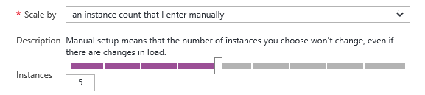
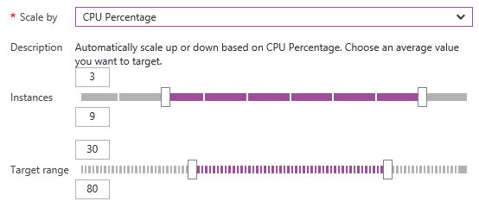
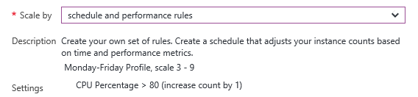
Manual Scaling vs. Auto-Scaling
Manual – Scale via portal or scripts
Auto – CPU Percentage
Auto – Schedule & Performance Rules
Notes:
Manual scaling can be as simple as moving a slider to increase the number of VM instances. Auto-scaling can be enacted by scaling the number of VM instances as CPU utilization increases, or through rules that you specify. An example of the latter is scaling up during certain hours of the day in which you anticipate peak demand.

Slide 22

Web App
Notes:
Demonstrate scaling out in this and the next two slides by showing the VM count increasing as traffic increases.

Slide 23
Web App

Slide 24
Web App

Slide 25
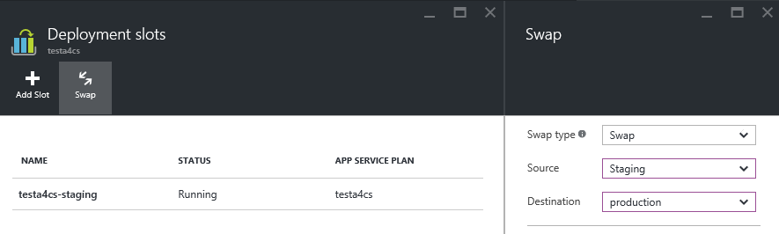
Deployment Slots
Use a Deploy-Confirm-Promote workflow
Promote via “swap” through Azure portal
http://sitename-slotname.azurewebsites.net
Notes:
When you deploy an Azure Web App, you can deploy to a separate deployment slot instead of the default production slot when running in the Standard or Premium App Service plan mode. Deployment slots are actually live web apps with their own hostnames. Web app content and configurations elements can be swapped between two deployment slots, including the production slot. Deploying your application to a deployment slot has the following benefits:
You can validate changes in a staging deployment slot before swapping it with the production slot.
Deploying a web app to a slot first and swapping it into production ensures that all instances of the slot are warmed up before being swapped into production. This eliminates downtime when you deploy your web app. The traffic redirection is seamless, and no requests are dropped as a result of swap operations. This entire workflow can be automated by configuring Auto Swap when pre-swap validation is not needed.
After a swap, the slot with the previously staged web app now has the previous production web app. If the changes swapped into the production slot are not as you expected, you can perform the same swap immediately to get your "last known good site" back
For more information, see https://azure.microsoft.com/en-us/documentation/articles/web-sites-staged-publishing/.

Slide 26
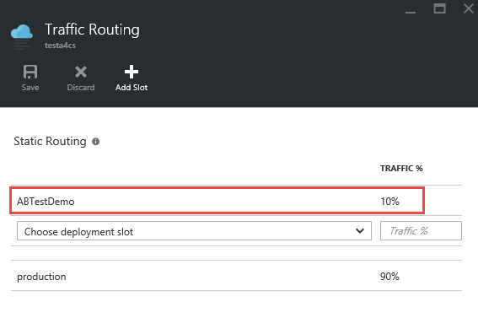
A/B Testing
Test changes by routing requests to different deployment slots
Use Traffic Routing to direct % of traffic to alternate slots
Notes:
A/B testing is useful for determining which of two landing pages, for example, is more effective in engaging customers. With Azure Web Apps, you can easily route traffic to different deployment slots by specifying percentage-based traffic allocations in the portal.

Slide 27






Continuous Integration
Web apps can be deployed manually via FTP or WebDeploy
Automate deployment using 3rd party source-control providers
Can also use a local Git repository from Azure Portal
Git
Visual Studio Team Services
CodePlex
GitHub
BitBucket
DropBox
Notes:
Continuous integration means deploying updates to your Web app as often as needed -- even several times a day. Azure supports many different deployment methods, including FTP, Git deployment (publishing from a local Git repository to Azure), and WebDeploy, which supports diff-deployment, database creation, and more. Visual Studio has integrated support for all three. Teams can also publish via third-party source-control providers such as Kudu (https://github.com/projectkudu/kudu/wiki/Deployment), which supports deployments from OneDrive and Dropbox, as well as repository-based deployments from GitHub, BitBucket, VSTS, and local Git repositories. For more information, see https://azure.microsoft.com/en-us/documentation/articles/web-sites-deploy/.

Slide 28


Continuous Integration + Deployment Slots
Production
5
Developer commits code
Automated process builds/compiles and deploys to staging slot
Automated and other tests validate content in staging slot
Staging content promoted to production
Users see updated site
1
4
2
3
Source Control
Staging
Test
Notes:
This process is a tried and tested one that is easily enacted using a combination of Azure features (e.g., deployment slots) and tooling support (e.g., Visual Studio).

Slide 29
App Service Plans
Billing and provisioning for App Service resources
 | Free | Shared | Basic | Standard | Premium
# of Apps | 10 | 100 | Unlimited | Unlimited | Unlimited
Shared Disk Space | 1 GB | 1 GB | 10 GB | 50 GB | 500 GB
Maximum Instances | 1 | 1 | 3 | 10 | 50
Autoscale | No | No | No | Yes | Yes
Staging Environments |  |  |  | 5 | 20
Custom Domains | No | Yes | Yes | Yes | Yes
SLA |  |  | 99.95%
Notes:
When you create an Azure Web App, you are asked to choose an App Service plan (or create a new one). These plans support 5 pricing tiers (Free, Shared, Basic, Standard, and Premium), with each tier offering a unique combination of capabilities and capacity. Apps in the same subscription and geographic location can share a plan. For more information, see https://azure.microsoft.com/en-us/documentation/articles/azure-web-sites-web-hosting-plans-in-depth-overview/.

Slide 30
Tech Course @PTIT FY 17
Lập trình website
với PHP và WordPress.

Slide 31
Content Tech Course Day 1 - PHP & MySQL, Overview WordPress. Day 2 – Code Template for WordPress. Day 3 – Code Plugin for WordPress. Introduce Hackathon. Day 4 – Presentation, Review Hackathon and Q&A Tech Course.
Du Van Nguyen
Technical Evangelist

Slide 32
Tech Course @PTIT FY17 Day 1
Du Van Nguyen
Technical Evangelist

Slide 33
Agenda
PHP & MySQL
Wordpress là gì?
Cài đặt Wordpress và MySQL Database, deploy lên Azure.
MySQL Database + Web serivce
Tổng quan về một website sử dụng Wordpress.
Giới thiệu về các thành phần trong Wordpress.
Wiget, Plugin, Appearance, …
Hướng dẫn cơ bản khi sử dụng WordPress.

Slide 34
PHP & MySQL
Notes:
First, let’s look at some design principles and at some platform features

Slide 35
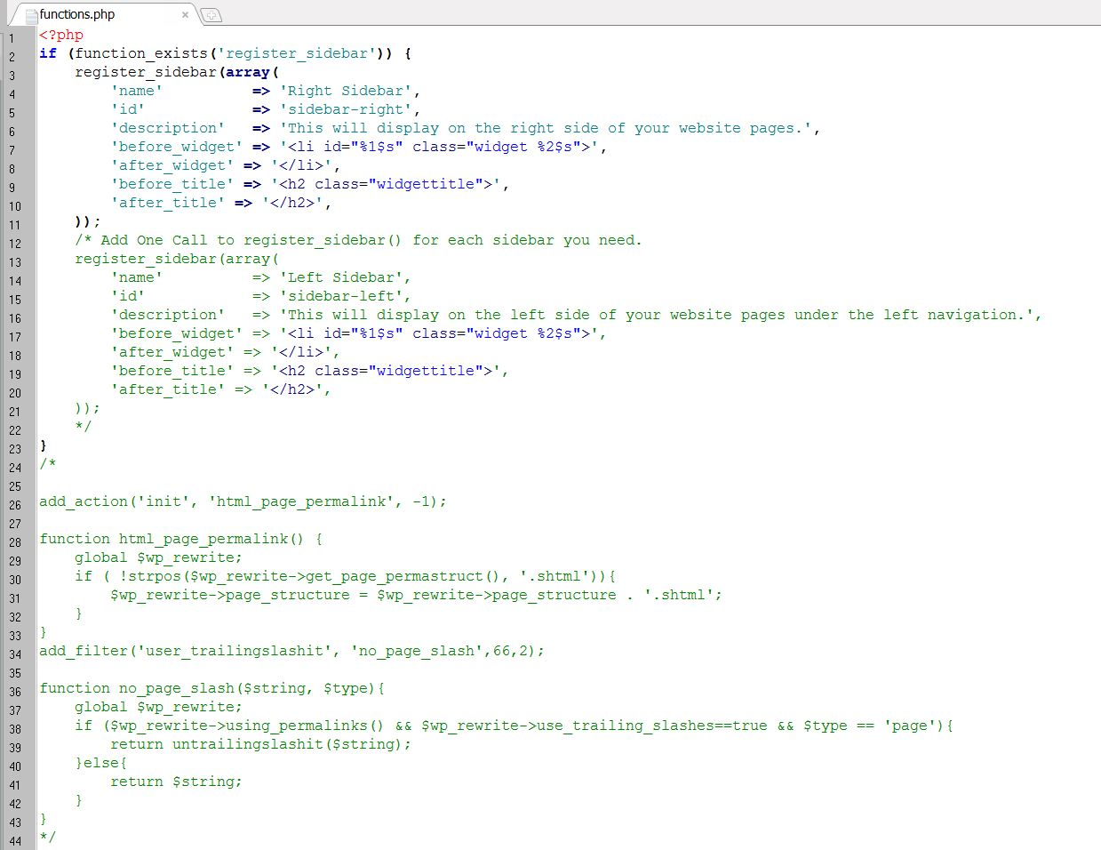
PHP & MySQL
PHP is a server scripting language, and a powerful tool for making dynamic and interactive Web pages.
PHP là gì?
PHP, là một ngôn ngữ lập trình kịch bản chủ yếu dùng cho phát triển các ứng dụng web vì khả năng tương thích và dễ dàng “nhúng” vào các đoạn HTML.
Lần đầu tiên xuất hiện vào năm 1995, phiên bản mới nhất là 7.0.10 ra mắt vào 18/8/2016
PHP được sử dụng rộng rãi, miễn phí và tỏ ra khá hiệu quả khi so sánh với những ngôn ngữ khác như ASP.NET
Learn more about PHP
http://www.w3schools.com/php/
Have you ever heard of Microsoft DreamSpark ?
https://www.dreamspark.com/

Slide 36
PHP & MySQL
MySQL is an open-source relational database management system for proprietary use
MySQL là gì?
MySQL là một hệ quản trị cơ sở dữ liệu mã nguồn mở cực kỳ phổ biến
Phiên bản đầu tiên được phát hành vào ngày 23/5/1995, phiên bản mới nhất là 5.7.14 ra mắt vào 29/7/2016
Bạn có thể dễ dàng tạo một MySQL server trên Azure hoàn toàn miễn phí qua tài khoản DreamSpark
Visit the Developer’s official Website
http://www.mysql.com/
Learn more about SQL
http://www.w3schools.com/sql/

Slide 37
WordPress
Notes:
First, let’s look at some design principles and at some platform features

Slide 38
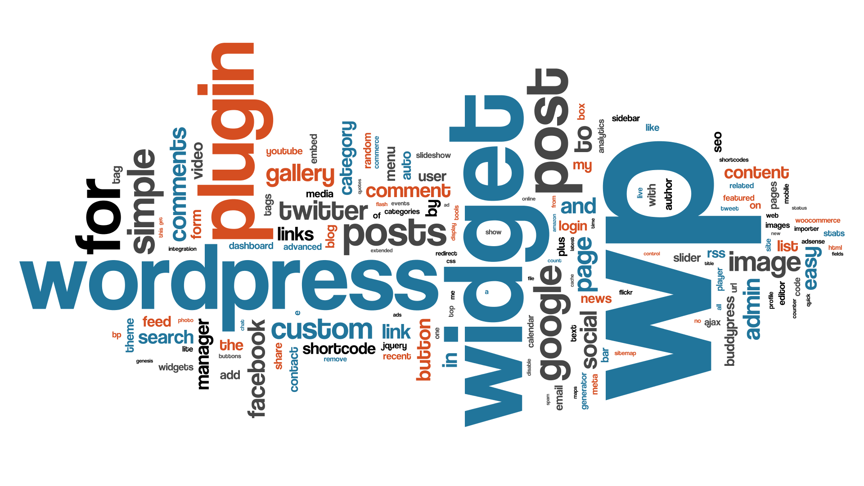

WordPress
Tại sao bạn nên sử dụng Wordpress ?
- Mã nguồn mở hoàn toàn miễn phí
- Cộng đồng Developers mạnh
- Dễ dàng cài đặt, quản lý, nâng cấp
- Ăn toàn và bảo mật cao
- Tùy biến trên nhiều nền tảng
- Ngày càng được hoàn thiện hơn ☺ - Là 1 mã nguồn hỗ trợ việc SEO, đẩy website của bạn lên top công cụ tìm kiếm tốt nhất. ☺

Slide 39
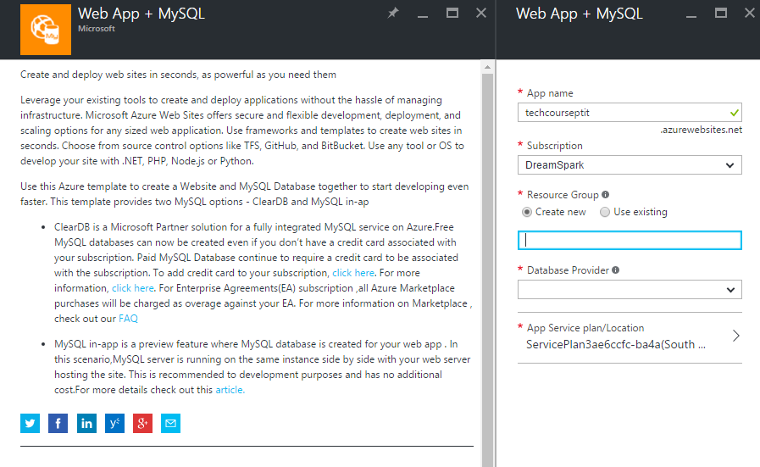
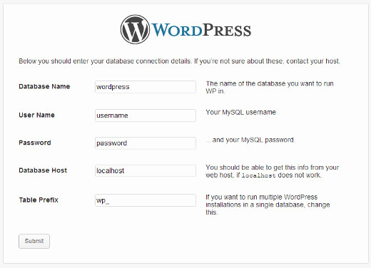
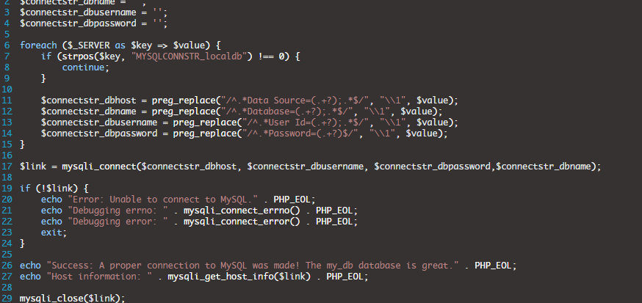
Create Web App using WordPress on Azure
Create Web App, MySQL Database & Wordpress
Fill the config form
Customize & code your site

Slide 40
Deploy time ☺
Notes:
Open the built-in Calculator app on a desktop.
Switch to the scientific layout as this has a richer UI.
Slowly resize the window, showing how parts of the UI are removed as the window size reduces, and that margins and spacing reduces as the screen gets smaller.
Point out that on desktop at the narrowest window, effectively what you are looking at is the Phone display layout.

Slide 41
Sau khóa học này, bọn mình hy vọng mọi người có thể bắt đầu website của chính bản thân, bắt đầu từ những themes, widget, v.v… Nếu bạn có thắc mắc gì, đừng ngần ngại đưa ra câu hỏi vào cuối mỗi buổi học ☺
Notes:
Firstly, you may notice that the Visual Studio 2015 New Project templates do not include examples of different styles of apps, unlike previous versions. In fact, for interactive apps, there’s only one new project template: the Blank App.
Microsoft is trying to be less prescriptive about design layouts than we have in the past. We want you to use your own designs, fonts and icons and with UWP you can do that.
If you want to seek inspiration and guidance on how to create an effective layout, you can take a look at the built-in apps that we ship with Windows 10.

Slide 42
WordPress Techniques
Notes:
Now let’s consider some guidelines on how to approach the task of creating an adaptive UI that scales well across multiple screen sizes and orientations.

Slide 43
Take a look
Tổng quan về website sử dụng WordPress
Dashboard
Appearance, WordPress Themes.
Wiget
Plugin
Notes:
Bear these three things in mind as you design the UI for your app:
React to window size change and modify the positioning of blocks of content, perhaps show and hide features
Think also of how the user is interacting with your app. Many of the built-in controls automatically adapt to touch vs mouse/keyboard input but you may also be able to refine your layouts based on input method
Trust the effective pixels system! Design in Visual Studio so that it ‘looks right’ and you can be confident it will ‘look right’ across a broad range of Windows 10 displays. You will still refine the content displayed on the page based on screen sizes, but you don’t have to adjust sizing on account of screen width.

Slide 45
Tech Course @PTIT FY17 Day 2 – Code themes for WordPress
Du Van Nguyen
Technical Evangelist

Slide 46
Cấu trúc giao diện trong WordPress
Root Themes Folder
functions.php
index.php
header.php
footer.php
page.php
single.php
content.php
content-none.php
archive.php
search.php
author.php
404.php
sidebar.php

Slide 47
functions.php
Là một file bắt buộc trong theme và nó sẽ chứa các đoạn code nguồn mà bạn muốn nó luôn được load mỗi khi tải website WordPress.
Notes:
First, let’s look at some design principles and at some platform features

Slide 48
header.php
Là một file chúng ta sẽ khai báo các thẻ HTML cần thiết mà trong một tài liệu HTML chuẩn đều có như <html>, <head>, <body>,….và nhất là phần thẻ <head> là phần quan trọng nhất.
Ngoài ra, chúng ta sẽ viết thêm code hiển thị tên website và menu cho file header.php để nó có thể xuất hiện được ở mọi nơi.
Notes:
First, let’s look at some design principles and at some platform features

Slide 49
footer.php
Tương tự như header, chúng ta sẽ code cho footer.php xuất hiện ở mọi nơi.
Notes:
First, let’s look at some design principles and at some platform features

Slide 50
index.php
là file sẽ làm trang chủ mặc định cho WordPress và chúng ta sẽ viết code hiển thị danh sách các post mới nhất trên website.
Notes:
First, let’s look at some design principles and at some platform features

Slide 51
content.php
Do ở file index.php chúng ta đã sử dụng hàm get_template_part() của WordPress để load cấu trúc các file content.php và những file content có liên quan. Cho nên, ở đây chúng ta sẽ bắt đầu viết code cho file này để hiển thị nội dung của post hoặc page.
Notes:
First, let’s look at some design principles and at some platform features

Slide 52
Post format
Do ở phần viết code cho functions.php, chúng ta có khai báo sử dụng tính năng Post Format nhằm mục đích cho các post type hiển thị khác nhau theo từng format riêng. Cho nên, ở phần này chúng ta sẽ viết code cho các post format mà chúng ta đã khai báo sử dụng trong functions.php

Slide 53
single.php & page.php
Single.php là file template cho việc hiển thị nội dung của một post type bất kỳ.
Page.php là để hiển thị thông tin chi tiết về các Page trong WordPress.

Slide 54
Code trang lưu trữ và trang 404
Các template phải code ở phần này là archives.php, author.php, search.php và 404.php, trong đó:
archive.php – Template chung dành cho các taxonomy.
author.php – dành cho trang riêng của từng tác giả, nếu không có file này nó sẽ load file archive.php.
search.php – dành cho trang hiển thị kết quả tìm kiếm.
404.php – hiển thị thông báo lỗi 404 trên website WordPress.

Slide 55
sidebar.php
Là nơi đặt các Wiget hiển thị nội dung bên cạnh khu vực hiện thị nội dung chính của website.
Để đăng kí một sidebar mới trong WordPress chúng ta sử dụng hàm: register_sidebar()
Để hiển thị sidebar lên khu vực cần hiển thỉ chúng ta sử dụng hàm: dynamic_sidebar()

Slide 56
Custom Page Template
Tạo ra những template riêng, ở đó bạn có thể code nó khác đi so với giao diện gốc của website để nhằm mục đích sử dụng nó cho một Page riêng biệt.
Ở đây, chúng ta sẽ code trên file contact.php và full-width.php trong thư mục templates của giao diện.

Slide 57
Code CSS cho themes
Sử dụng hàm wp_register_style() để đưa CSS vào themes WordPress.
Sử dụng hàm wp_enqueue_style() và wp_enqueue_scripts() để gọi nó ra giao diện theo một cách chuyên nghiệp.

Slide 58
Thêm chức năng Theme Option
Ở đây chúng ta sẽ tạo ra một khu vực quản lí riêng cho giao diện của mình, giúp các bạn có thể thay đổi logo, màu chữ,…v.v một cách dễ dàng và chuyên nghiệp hơn.

Slide 59
TIME FOR CODE THEMES WORDPRESS ☺
Notes:
Open the built-in Calculator app on a desktop.
Switch to the scientific layout as this has a richer UI.
Slowly resize the window, showing how parts of the UI are removed as the window size reduces, and that margins and spacing reduces as the screen gets smaller.
Point out that on desktop at the narrowest window, effectively what you are looking at is the Phone display layout.

Slide 60
Tech Course @PTIT FY17 Day 3 – Code plugin for WordPress
Du Van Nguyen
Technical Evangelist

Slide 61
Plugin là gì?
là một phần mềm, hay nói cách khác nó là một hay nhiều tập tin PHP có chứa nhiều dòng lệnh hoặc hàm (function) do người dùng viết ra. Và dĩ nhiên nếu đã là các tập tin PHP thì plugin sẽ phải được viết với ngôn ngữ PHP, trong đó ngoài các hàm do người dùng tạo ra thì còn các hàm kế thừa từ thư viện có sẵn của WordPress.

Slide 62
Kiến thức cần có để viết 1 plugin?
HTML và CSS cơ bản.
PHP cơ bản.
Kiến thức về Action Hook và Filter Hook trong WordPress.

Slide 63
Cấu trúc của 1 plugin WordPress
Rất đơn giản.
Bạn chỉ cần tạo folder chứa các file nguồn của plugin, ví dụ: simple_plugin
Sau đó, bạn tạo file php có tên trùng với tên folder nguồn, ở đây là: simple_plugin.php
Ngoài ra, để submit lên Store plugin của WordPress, bạn cần bổ sung các tập tin ngoại khác như css, js, và readme.txt.

Slide 64
Hook là gì?
- Là một khái niệm do WordPress đưa ra, cho phép các bạn thực thi một hàm nào đó vào một thời gian thực.

Slide 65
Action Hook là gì?
Là một loại hook, cũng là 1 hàm PHP nào đấy. Nó được đặt ở một ví trí nhất định cho phép các bạn có thể gọi một lệnh nào đấy tại vị trí mà bạn đặt Action Hook.
Ví dụ: Bạn muốn thêm 1 đoạn code js vào footer trước khi đóng thẻ </body> thì bạn có thể tra cứu và sử dụng hàm hook wp_footer.

Slide 66
Filter Hook là gì?
Là một loại hook, nó được đặt nằm giữa cơ sở dữ liệu và trình duyệt web, khi bạn thực thi một câu lệnh nào đó thì đều phải thông qua ít nhất một Filter, và dĩ nhiên đây cũng là một hàm PHP.
Filter đóng vai trò là người quản lý, nó sẽ lọc những thông tin người dùng muốn đưa vào cơ sở dữ liệu và ngược lại.

Slide 67
Shortcode là gì?
Là một đoạn code ngắn.
Có tác dụng thực thi tác vụ gì đó mà bạn đã định sẵn cho nó trong lúc tạo shortcode.
Ví dụ: Khi bạn viết 1 plugin, các bạn khai báo shortcode tại file nguồn của plugin đó, thì khi bạn muốn sử dụng chức năng của plugin mà các bạn đã viết thì các bạn chỉ việc gọi shortcode ra là hoàn toàn thực thi được.

Slide 68
TIME FOR CODE PLUGIN WORDPRESS ☺
Notes:
Open the built-in Calculator app on a desktop.
Switch to the scientific layout as this has a richer UI.
Slowly resize the window, showing how parts of the UI are removed as the window size reduces, and that margins and spacing reduces as the screen gets smaller.
Point out that on desktop at the narrowest window, effectively what you are looking at is the Phone display layout.

